Slide 1


CISC7016/CISC8001
Advanced Topics in Computer Science
Department of Computer and Information Science
Faculty of Science and Technology
Neural Cellular Automata GAN(NCA-GAN)
Xuhang Chen, YC174911, yc17491@umac.mo
Yan Xian, MC14965, mc14965@umac.mo

Slide 2
Introduction
Neural Cellular Automata(NCA)
Definition:
Computational systems characterized by being discrete on both spatial and temporal scales and abstract.
Four fundamental features:
discrete n-dimensional lattice of cells
discrete states
local interactions
discrete dynamics
Example:
Conway's game of life

Slide 3
Neural Cellular Automata(NCA)
One of the possible application of CAs is to biological systems, aiming at reproducing one of the most striking processes that characterize all the life forms: morphogenesis
The elemental building blocks of living organisms are able to cooperate with their neighbors in
deciding the shape, location and size of the organs and body parts
building all the necessary interconnection between them
knowing when, what and how to regenerate damaged portions of the organism
The Cellular Automaton will consist of a grid of cells that will be iteratively updated following the same update rule and in a way that the state of each cell depends only on those of its neighbors.
In this context, simulating this processes means identifying the rules at elemental unit level which give rise to the macroscopic regenerative behaviour

Slide 4
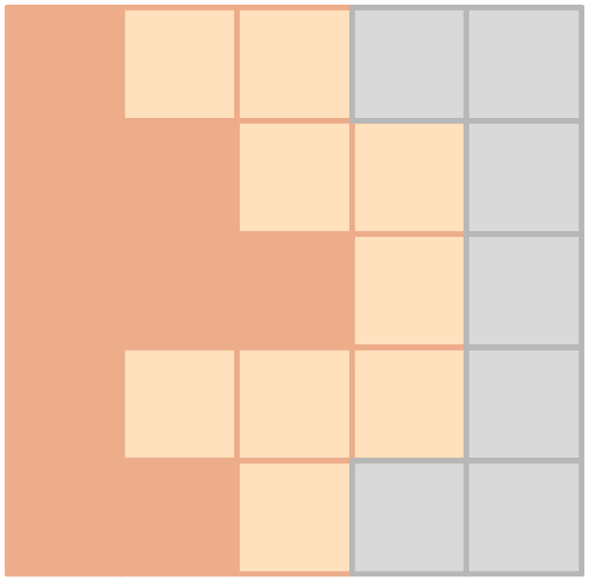
Cell States
Although not typical, continuous valued cell states have been used, which
makes the update rule a differentiable function of the cell’s neighbourhood’s states
better simulates the actual mechanism that rules living organisms’ bodies
The cell state is a 16-dimensional real-valued vector
the first three channels represent the cell color visible to humans (RGB)
the 4-th channel, alpha channel ⍺, has the role of defining living cells
⍺_{cell} > 0.1 ⇒ cell’s neighbors are considered living, and the cell is mature
⍺_{cell} ≤ 0.1 ⇒ cell’s neighbors are dead (⍺_{cell} = 0), and the cell is growing
hidden channels do not have a specific meaning: they carry some information
which can find several biological interpretations

Slide 5
Why
There are a couple of common feature between NCA and Convolutional Neural Networks(CNNs)
Neural networks can act as universal function approximator ⇒ each transition Σn ∍ σ → Ф(σ) ∊ Σ can be approximated by a complex enough neural network
The single neighborhood operator Ф can be implemented as embedded in a convolutional neural network: it is applied to all pixels’ (cells) neighborhood once the network has been fed with an input image
The transition rule must be the same for each cell and can depend solely on the 3x3 neighborhood of the cell ⇒ convolution operation

Slide 6
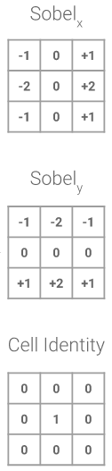
NCA rule
The update rule is divided into 4 phases
Perception
implemented using three 3x3 convolutions with fixed kernels obtained by applying two Sobel filters and an identity filter
48-dimensional perception vector
Update rule
using 1x1-convolutions and ReLU nonlinearity, each cell operate over the perception vector
the update of the cells states are incremental, applied before each time step
Stochastic cell update
single cell’s updates are assumed as independent, separated by time intervals of random duration
random per-cell mask
Living cell masking
dead cells are forbidden from carrying out computations over the perception vector

Slide 7
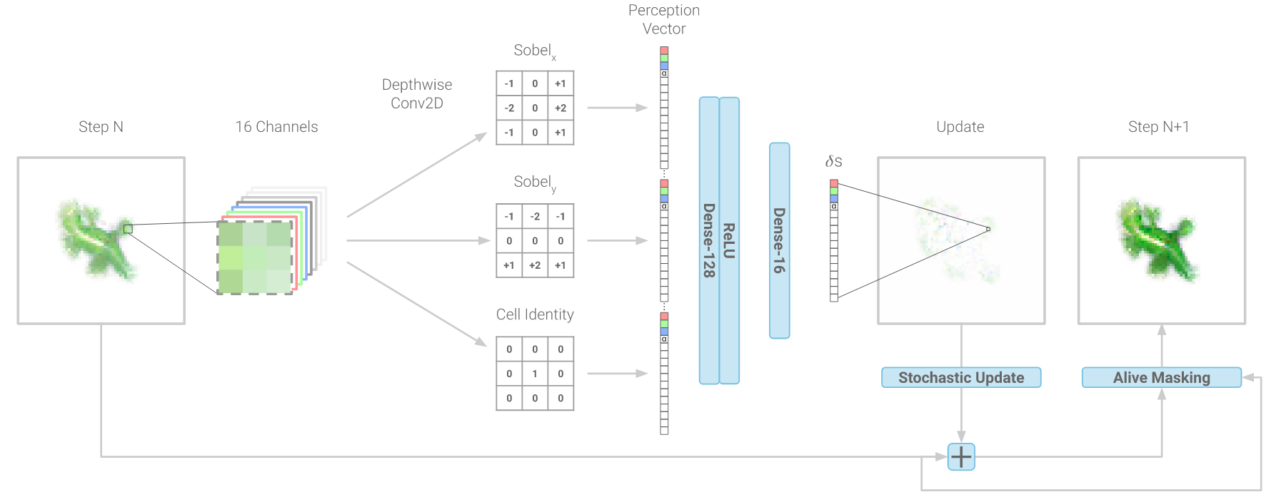
Example
The output of a single update step is then fed back into the NCA
the procedure is carried on for a few dozens iterations
the same architecture with the same weights is used during this steps

Slide 8
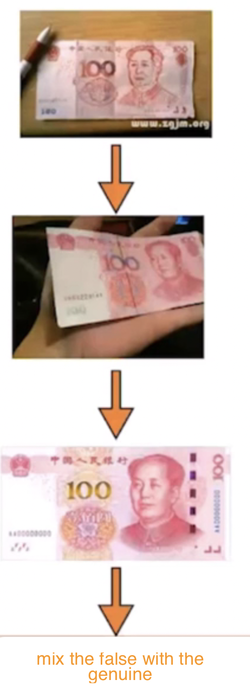
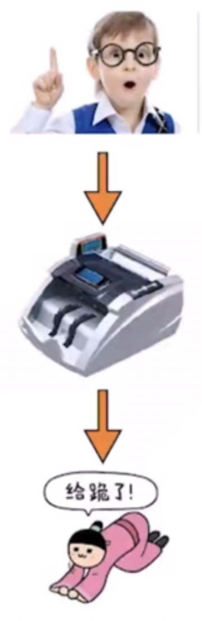
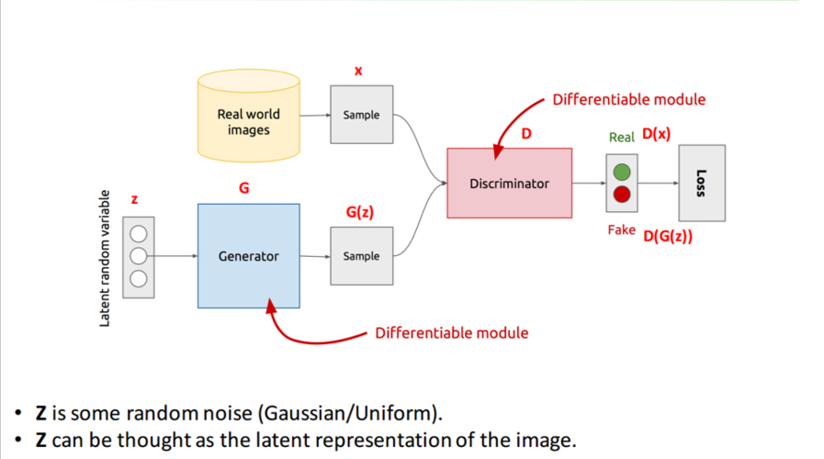
Introduction(cont.)
Generative Adversarial Network (GAN)
Generator + Discriminator
Generator(G) Discriminator(D)
Notes:
GAN 背后的思想非常直观：生成器和鉴别器两个网络彼此博弈。生成器的目标是生成一个对象（比如人的照片），并使其看起来和真的一样。而鉴别器的目标就是找到生成出的结果和真实图像之间的差异。通过不断训练，使得两者的水平都得到提高。
用造假币的例子理解。
知道真实的币之后，先造一个假币，骗过小孩，初级判别器。进一步提高造假技术，骗过验钞机（能力得到提升的判别器）。最后生成器不断学习，造出的假币以假乱真，骗过判别器。在这个过程中，G和D都得到了提升。
The idea behind the GANs is very straightforward. Two networks -- a Generator and a Discriminator play a game against each other. The objective of the Generator is to produce an object, say, a picture of a person, that would look like a real one. The goal of the Discriminator is to be able to tell the difference between generated and real images.Through continuous training, the generator and discriminator are enhanced.

Slide 9
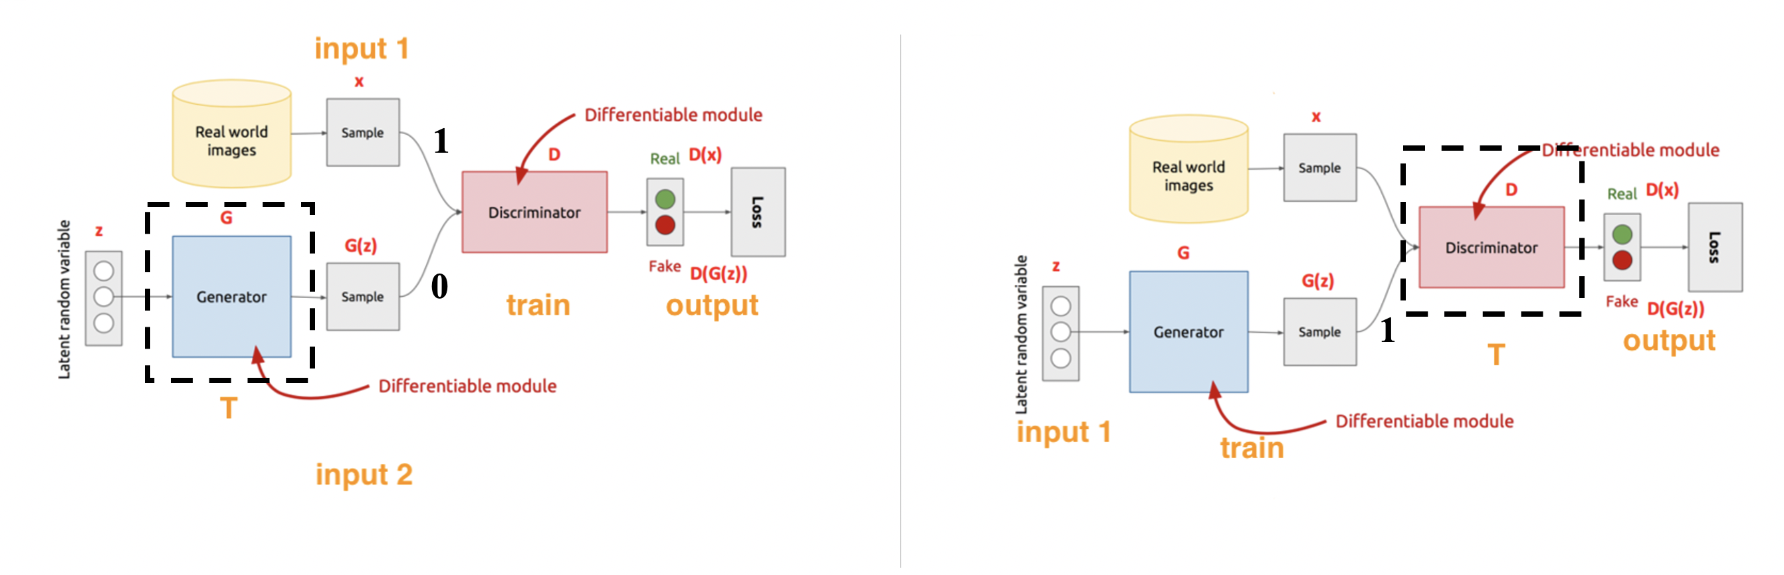
Generative Adversarial Network
Training Process
Notes:
1.先固定生成器，训练判别器。真实数据input 1和虚假的input2传递给判决器让其区分
2.判决器能力得到提升后，固定判决器，训练生成器。z是均值为0，方差为1的正态分布的向量，传递给generator产生fake data，目的是欺骗判决器，fake data通过判决器后，输出为1。

Slide 10
Related works
NCA can be regarded as a neural network[2]
NCA can generate images/patterns[3]
NCA with variational auto encoder can be a promising generative model[4]

Slide 11
Related works(Cont.)
VAE can be a generator in GAN[5]
NCA-GAN combination is present[6]

Slide 12
Challenges/Motivations
NCA
Need enhancement or other auxiliary components such as VAE
Discriminator
Match the generative capability of NCA
Loss function
Find a good loss function

Slide 13
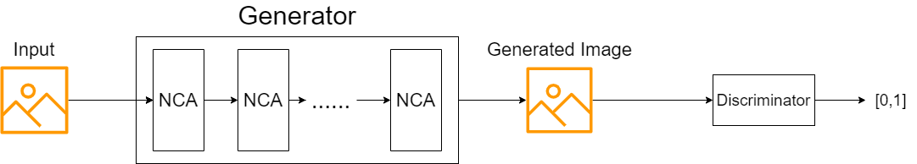
Methodology
Our Generative Model
Typical GAN style, generator is replaced by NCA or its variants
Datasets
MNIST/CIFAR
CelebA
Metrics
PSNR/SSIM

Slide 14




Results
Some current results:

Slide 15
References
Goodfellow I, Pouget-Abadie J, Mirza M, Xu B, Warde-Farley D, Ozair S, Courville A, Bengio Y. Generative adversarial networks. Communications of the ACM. 2020 Oct 22;63(11):139-44.
Gilpin W. Cellular automata as convolutional neural networks. Physical Review E. 2019 Sep 4;100(3):032402.
Mordvintsev A, Randazzo E, Niklasson E, Levin M. Growing neural cellular automata. Distill. 2020 Feb 11;5(2):e23.
Chen M, Wang Z. Image Generation With Neural Cellular Automatas. arXiv preprint arXiv:2010.04949. 2020 Oct 10.
Larsen AB, Sønderby SK, Larochelle H, Winther O. Autoencoding beyond pixels using a learned similarity metric. InInternational conference on machine learning 2016 Jun 11 (pp. 1558-1566). PMLR.
Otte M, Delfosse Q, Czech J, Kersting K. Generative Adversarial Neural Cellular Automata. arXiv preprint arXiv:2108.04328. 2021 Jul 19.

Slide 16

Q&A

